Slide 1
Treatment Options for Anxiety in Individuals with Intellectual and Developmental Disorders
Laura Politte, M.D.
Child and Adolescent Psychiatrist
Carolina Institute for Developmental Disabilities
May 10, 2017

Slide 2
Learning Objectives
Identify unique presentations of anxiety in individuals with intellectual and developmental disorders (I/DD).
Evaluate the evidence for pharmacological and non-pharmacological interventions for anxiety in individuals with I/DD.
Review practical strategies for managing anxiety symptoms.
Identify barriers to treatment and future directions for research and the care of individuals with I/DD and anxiety.

Slide 3
First, a caveat…
Research about treatment options in broadly defined intellectual and developmental disability (I/DD) is limited.
Most of the evidence comes from studies in autism spectrum disorder (ASD).
However, many of the strategies for ASD can be useful for people with other developmental disorders, too.

Slide 4
Anxiety: Overview and Definitions
Anxiety: “a feeling of worry, nervousness, or unease, typically about an imminent event or something with an uncertain outcome”
Anxiety exists on a spectrum:
Useful Debilitating
Anxiety disorders: typically defined by the Diagnostic and Statistical Manual, 5th Edition (DSM-5)
Symptoms are frequent, severe, and cause significant distress or impairment
Treatment usually warranted

Slide 5
When is treatment warranted?
Focus on level of individual distress and functional impairment:
Interferes with developing friendships
School avoidance/ refusal
Disruption to family functioning
Sleep disturbance
Significant tantrums/ meltdowns
Faltering academics
Compulsive behaviors that distresses child/ interfere with daily functioning

Slide 6
DSM-5 Anxiety Disorders
Separation Anxiety Disorder
Selective Mutism
Specific Phobia
Social Anxiety Disorder
(Obsessive Compulsive Disorder)
Panic Disorder
Agoraphobia
Generalized Anxiety Disorder
Substance-/Medication-Induced Anxiety Disorder
Anxiety Disorder due to a General Medical Condition
*These categories have driven most anxiety-related research and drug development.

Slide 7
Anxiety in ID and Genetic Syndromes
Prevalence of anxiety is 3-22% in ID
Challenge of “diagnostic overshadowing”
Genetic syndromes with high rates of anxiety:
Fragile X syndrome
Social anxiety, sensory defensiveness
Williams syndrome
Phobias
Angelman syndrome
Separation anxiety, social anxiety

Slide 8
Anxiety in ASD
Anxiety is very common (prevalence~ 40% in ASD)
May fit DSM-5 definitions or present as “atypical” variant
4 most frequent DSM disorders include:
Specific phobias (e.g., fear of the dark, insects, needles)
Generalized anxiety disorder
Social anxiety disorder
Obsessive Compulsive Disorder
Symptoms don’t always map neatly onto DSM-5 defined categories
Positive association between anxiety and IQ

Slide 9
Anxiety in ASD: Symptom Overlap
ASD
Anxiety
Extreme upset with change, deviation from routine
Insistence on sameness
Discomfort in social situations
Aversiveness to sensory stimuli

Slide 10
Anxiety in ASD and ID
Anxiety
Sensory defensiveness
Social skills deficits/ peer rejection
Difficulty tolerating unpredictability
Difficulty with change/ transitions
Rigid thought patterns
Communication impairment

Slide 11
Social Anxiety in ASD
Social Anxiety
Elevated physiological arousal
Social skills deficits
Insight into social differences
More common in older kids with average or above-average IQ (greater social awareness).
Fear of negative evaluation
by peers may be a realistic
concern.
Distinct from avoidance of social interactions due to lack of interest.
Risk factors for social anxiety

Slide 12
ASD and OCD
Where do we draw the line?
Fixated, restricted interests Obsessions
Repetitive behavior Compulsions
Distress with rituals/ compulsions may help distinguish, but not always
Hoarding, compulsive ordering, and repetition may be more common in ASD

Slide 13
Assessment of Anxiety in ASD and ID
Initial Evaluation:
Detailed history of anxiety symptoms in key areas
Tolerance of change, sensory sensitivities, fears/ phobias, social anxiety, etc
Rule out medical cause (pain/discomfort, hyperthyroidism, med effect)
Determine cognitive/ verbal levels
Are there modifiable contributing factors?
Undiagnosed learning difficulties? Peer bullying? Lack of structure/ routine?
Is there psychiatric comorbidity that might influence treatment?
Comorbid ADHD, depression, severe irritability

Slide 14
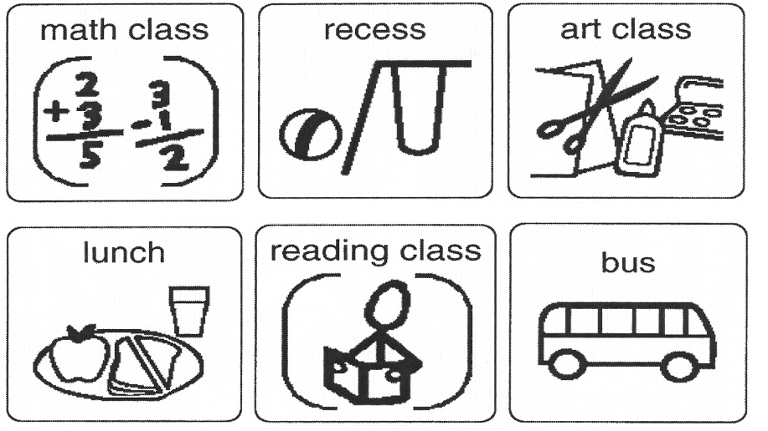
Treatment of Anxiety in ASD and ID
Address specific sources of anxiety with behavioral interventions first:
Sensory defensiveness: OT, noise-cancelling headphones, accommodations for overstimulating situations, weighted blanket, self-soothing strategies
Difficulty tolerating the unknown/ change: Use of social stories, previewing new situations, written/ picture schedules, transitional objects, visual timers, graded exposure
Social anxiety: Cognitive
Behavioral Therapy (CBT), social skills building
Fears/ phobias/ compulsions: CBT; exposure
therapy

Slide 15
Non-Pharmacological Interventions with Positive Evidence for Anxiety in ASD
Cognitive-Behavioral Therapy
Documented efficacy for both group and individual interventions
Moderate effect sizes (in higher-functioning youth)
Social Skills Training
Especially for social anxiety
May be woven into CBT

Slide 16
Cognitive Behavioral Therapy for ASD/ID
Core Components:
Psychoeducation about anxiety (e.g., helpful vs unhelpful anxiety; cognitive, behavioral, and physiological components)
Cognitive strategies (identify and challenge anxious cognitions)
Behavioral strategies (graded exposure, exposure and response prevention, behavioral “experiments” to test anxious predictions)
*In ASD, may need to adapt to capitalize on strengths, account for ASD-related deficits, and appeal to unique interests.

Slide 17
CBT adaptations for ASD
“Chunking” of content, alternating with down time
Use of special interests unique to individual
Helps to build therapeutic rapport
Increases engagement and enthusiasm
Offers opportunity for concrete, accessible metaphors
Inclusion of social skills instruction
For lower verbal/ cognitive ability:
Focus is on behavioral, not cognitive interventions
Increased parent involvement and manipulation of environment

Slide 18
ASD-Specific Treatment Protocols
Multimodal Anxiety and Social Skills Intervention
Facing Your Fears*
Behavioral Interventions for Anxiety in Children with Autism

Slide 19
Facing Your Fears: Example of Group Therapy
15 weekly, 90 min sessions with parent and child components
Designed for children with high-functioning autism and social phobia, generalized anxiety disorder, separation anxiety disorder, or specific phobia
CBT-based interventions, adapted for ASD
*Offered locally at TEACCH
Chapel Hill Center (ages 8-14)

Slide 20
Facing Your Fears: Essential Elements
Identify child’s worries and associated behaviors, symptoms
Understand connection between body’s reaction and anxious thoughts
Externalize anxiety symptoms (“worry bugs”, “helper bugs”)
Recognition of automatic negative thoughts
Learn relaxation strategies and activities, positive coping statements
Create a hierarchy of anxiety-provoking situations
Develop graded exposure activities based on individual hierarchy
Social skills building
Create and star in a Facing Your Fears video

Slide 21
Tips and Strategies for Home
For caregivers:
Keep a calm, confident demeanor
Validate, but don’t reinforce anxious thoughts/ feelings
Redirect when anxious talk becomes perseverative
Provide support, but don’t avoid the source of anxiety
Encourage child to develop self-help strategies
Reward efforts at bravery
For kids:
Use a visual scale to identify levels of anxious feelings and behaviors
Practice self-help strategies (deep breaths, muscle relaxation, taking a break)
Identify a calming space
Graded exposure (with adult support)

Slide 22
Graded Exposure Hierarchy Example: Fear of Insects
Find and hold a caterpillar outside
Visit a butterfly house
Look at insects in glass containers
Watch You Tube videos of spiders
Stand next to Dad while he holds a caterpillar
Imagine self holding a bug
Pair exposures with relaxation strategies as needed
Establish rewards for accomplishing each step

Slide 23
The Incredible 5-Point Scale (http://www.5pointscale.com/)
Helps children recognize stages of specific challenge and identify self-calming strategies at each stage (1-5)
Can be adapted to a range of emotions/ behaviors
Identify in child’s own words:
Term to describe behavior at each level
What behavior feels like to him/ her at each level
What the child, teacher, parent can do to address behavior at each level

Slide 24
The Incredible 5-Point Scale: Examples

Slide 25
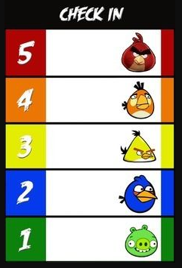
The Incredible 5-Point Scale: Examples

Slide 27
Medication Interventions for Anxiety
No published clinical drug trials specifically for anxiety in ASD
Underdeveloped area of research
Clinicaltrials.gov:
1 open-label buspirone trial
1 withdrawn buspirone randomized, controlled trial (RCT)
1 sertraline RCT in 2-5 year olds (anxiety is secondary outcome; primary is a cognitive measure)
1 mirtazapine RCT
Multiple oxytocin trials with anxiety as secondary outcome
All other trials are for CBT, social skills training, or other behavioral therapies

Slide 28
Why are medication trials for anxiety in ASD/ID so scant?
Difficulty in defining anxiety in ASD/ID
Symptom overlap
Limits of self-report
Lack of well-established outcome measures
Heterogeneity within the ASD/ID populations
Lack of defined biomarkers
Costly and difficult to undertake

Slide 29
SSRIs approved for anxiety in children without ID/D
Medication | FDA Indication | Approved Ages
Duloxetine* | Generalized Anxiety Disorder | 7+
Fluoxetine | OCD; Depression | 8+ (OCD), 7+ (depression)
Sertraline | OCD | 6+
Fluvoxamine | OCD | 8+
Escitalopram | Depression | 12+
Clomipramine | OCD | 10+

Slide 30
SSRIs in Children with ASD
Despite being commonly prescribed (about 32%), evidence supporting SSRI use in ASD/IDD is limited.
1 large, negative study of citalopram for repetitive behavior
Increased risk of behavioral side effects (“activation”) and insomnia
1 large, negative study and 1 smaller, positive study of fluoxetine for repetitive behavior
1 positive study of fluoxetine for repetitive behavior in adults
1 negative open-label study of fluvoxamine in children
Poorly tolerated in children, but some benefit in adults
*SSRIs may be more effective and better tolerated in adults than children with ASD.
*No studies yet with anxiety as the primary outcome of interest.

Slide 31
Buspirone
Buitelaar et al (1998):
Open label buspirone (15-45 mg/day) for 6-8 weeks
22 children with Autistic Disorder (N=2) or PDD-NOS (N=20), ages 6-17
Target symptoms: Anxiety = 14, Irritability = 1, Anxiety + Irritability = 7
9/22 with marked improvement, 7 with moderate improvement
Well-tolerated
Buitelaar JK et al. J Clin Psychiatry. 1998 Feb;59(2):56-9.

Slide 32
Buspirone
Chugani et al (2015):
166 children, ages 2-6, 24-week randomized, controlled trial
Anxiety measures were secondary outcomes
Improvement in repetitive behavior scores primary outcome
Significant improvement in Anxiety Composite score for children taking 2.5 mg twice a day (p<0.001) or placebo (p=0.004), but not 5 mg twice a day (p=0.214).
No significant adverse effects
Chugani DC et al. J Pediatr 2016;170:45-53.

Slide 33
Use of Medication for Anxiety
(Off-label) prescribing guidelines:
Start with SSRI (fluoxetine or sertraline) at very low dose (liquid preparations can help). Follow similar monitoring guidelines as used in anxiety in children without ASD.
Consider buspirone or mirtazapine as alternatives.
Less likely to cause behavioral activation.
Buspirone now studied in young children (2-6)
Mirtazapine may also be helpful for sleep, poor appetite
Use benzodiazepines only with caution.
Paradoxical agitation is common.

Slide 34
Use of Medication for Anxiety
Suggested dosing guidelines*:
Fluoxetine:
Prepubertal: Start 2 mg daily x2 wk, then increase by 2 mg every 2 wk up to max of 20 mg/day.
Adolescents: Start 5 mg daily x2 wk, then increase by 5 mg every 2 wk up to max of 40 mg/day.
Sertraline:
Prepubertal: Start 5 mg daily x2 wk, then increase by 5 mg every 2 wk up to max of 100 mg/day.
Adolescents: Start 12.5 mg daily x2 wk, then increase by 12.5-25 mg every 2 wk up to max of 200 mg/day.
*Suggestions only, no evidence base for use in ASD/ID.

Slide 35
Use of Medication for Anxiety
Suggested dosing guidelines*:
Buspirone:
Prepubertal: Start 2.5 mg daily x1 wk, then 2.5 mg twice daily x1 wk, then increase by 2.5 mg/day every 1 wk as needed/ tolerated. Max dosing 20 mg twice daily.
Adolescents: Start 2.5 mg twice daily x1 wk, then 5 mg twice daily x1 wk, then increase by 2.5 mg daily weekly up to max of 20 twice daily. Increase up to 20 mg three times a day as needed.
Mirtazapine:
Prepubertal: Start 3.75 mg (1/4 of 15 mg tab) daily x2 wk, then increase by 3.75 mg every 2 wk as needed up to max of 45 mg/day.
Adolescents: Start 7.5 mg (1/2 of 15 mg tab) daily x2 wk, then increase by 7.5 mg every 2 wk up to max of 45 mg/day.
*Suggestions only, no evidence base for use in ASD/ID.

Slide 36
Challenges to Treatment/ Future Directions
Clinicians with expertise in both ASD and anxiety are hard to find
Fewer still trained in CBT
Even fewer in private practice accept insurance
Limited resources in rural areas
Long waiting lists in well-resourced areas
Lack of evidence base for medication use

Slide 37
Summary: Treatment of Anxiety in ASD/ ID
Target the source of anxiety with appropriate behavioral interventions.
Modify the environment as needed.
CBT, social skills, behavioral therapy considered first-line.
Limited evidence base for psychotropic medication.
Consider cautious SSRI, buspirone, or mirtazapine trial.
Consider age, side effect profile, and previous treatments when selecting agent.
Start low, go slow.

Slide 38
Additional Resources
TEACCH Chapel Hill, Facing Your Fears group: http://teacch.com/regional-centers/chapel-hill-teacch-center/face-your-fears-intervention-group
Autism Treatment Network Blood Draw Toolkit: https://www.autismspeaks.org/science/resources-programs/autism-treatment-network/tools-you-can-use/blood-draw-toolkits
The Incredible 5-Point Scale: http://www.5pointscale.com/smart_ideas.htm
Autism Treatment Network Medication Decision Aid: https://www.autismspeaks.org/science/resources-programs/autism-treatment-network/tools-you-can-use/medication-guide
Association for Behavioral and Cognitive Therapies (finding a CBT therapist): http://www.findcbt.org/xFAT/

